Slide 1
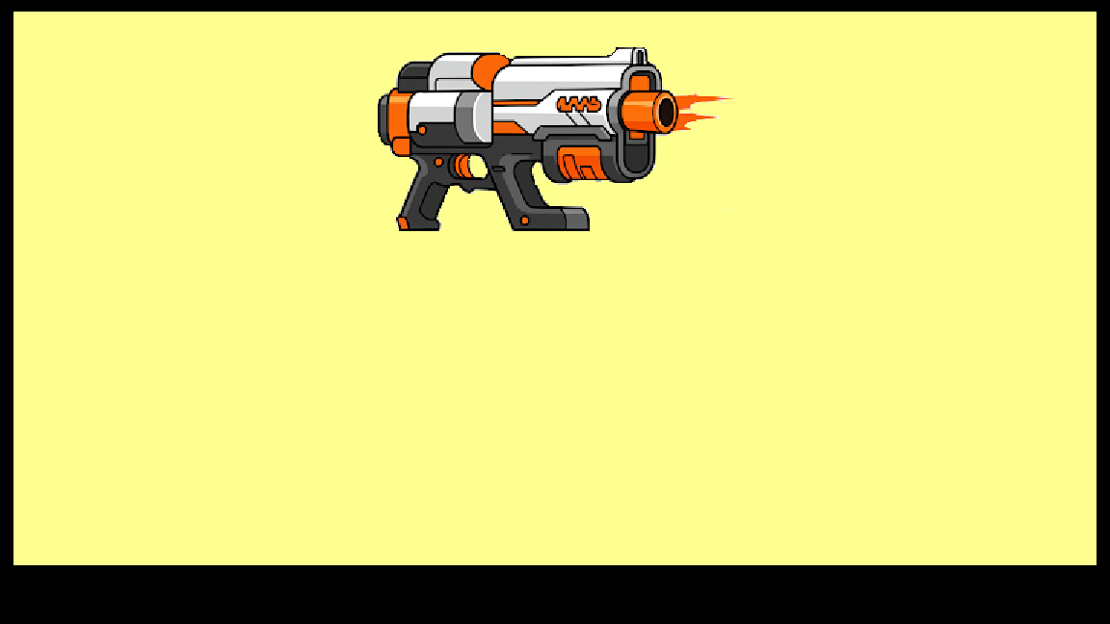
ALT-F4 using NERF
Automatic Light Turret for Far-Reaching Firing Feedback
Group 3

Slide 2


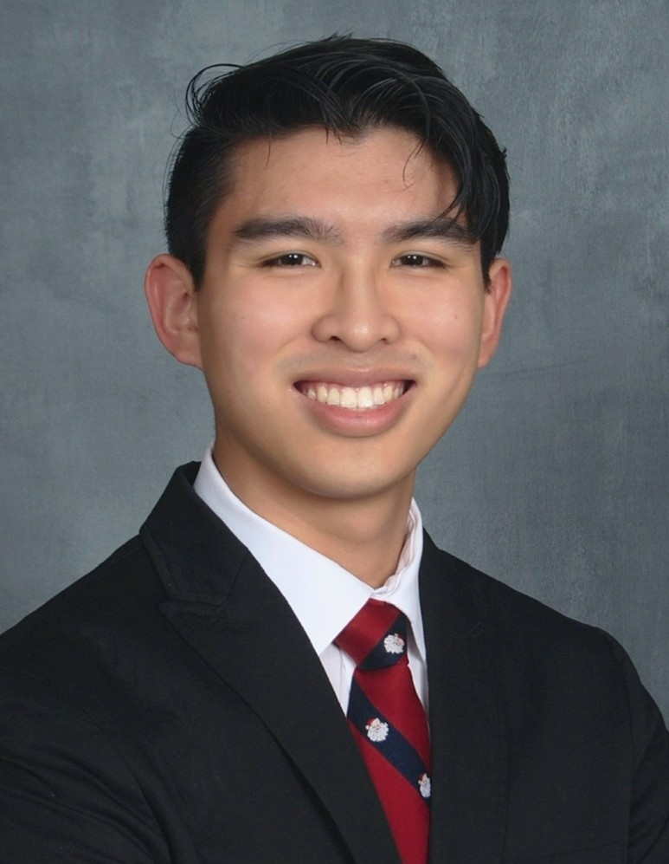
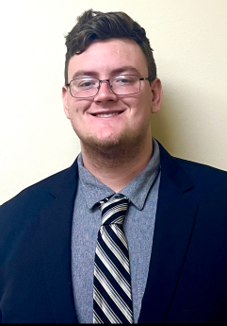
Meet The Team
Jose Castaneda
Electrical Engineering
Gabriel Taylor
Photonic Science and Engineering
Joshua Nguyen
Computer Engineering
Andrew Herbert
Computer Engineering

Slide 3
Motivation
Gabriel Taylor PSE
Security of large areas requires manpower
Guards cannot lose focus for extended periods of time
Guards are also at risk in case of an attack
ALT-F4 would defend an area with minimal manpower
ALT-F4 can remain attentive for as long as there is power

Slide 4
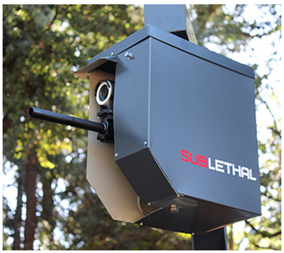
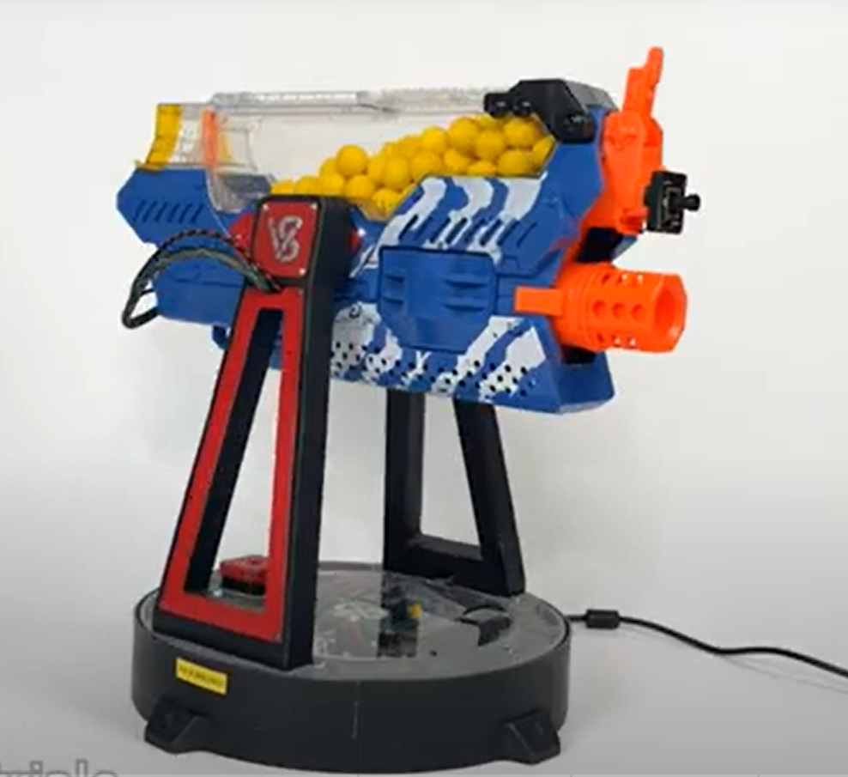
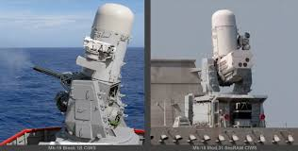
Similar Products
Gabriel Taylor PSE
Boomslang 2
Sublethal turret
No motion sensors
Nerf Turret
Shoots constantly or doesn’t shoot at all
Short effective range
Phalanx Close-In Weapon System (CIWS)
Very advanced tracking
Expensive to create and shoot rounds

Slide 5
Goals and Objectives
Gabriel Taylor PSE
Accurately calculate the trajectory of multiple different NERF blasters using photodetector grids
Detect objects in an image and determine how far each object is utilizing 2 cameras
Have a wide effective range in which the turret is very accurate
Remain powered for extended periods of time with efficient power usage

Slide 6
Engineering Specifications
Gabriel Taylor PSE
Component | Parameter | Specification
Motors | Aiming at the target | 5 seconds
Cameras | Target Acquisition | 5 seconds
Photodetector Grid | Accuracy of calculated trajectory
Cameras | Accuracy of range finding | 20 meters ±.2 meters
Battery | Battery life | 5 hours
Base of the turret | Range of motion | 360° horizontally 60° vertically
ESP32 | Input delay from the app | 1 second
±10% of the true trajectory

Slide 7
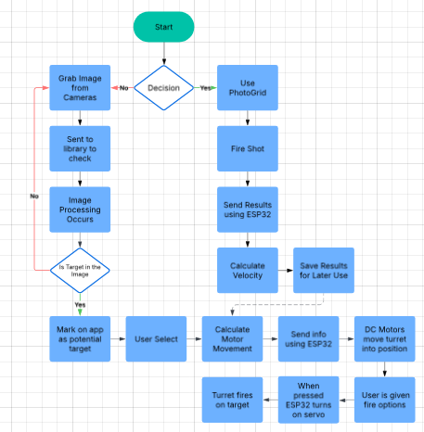
Software Block Diagram
Andrew Herbert CPE

Slide 8
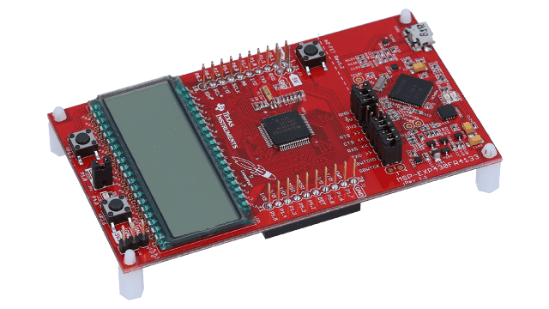
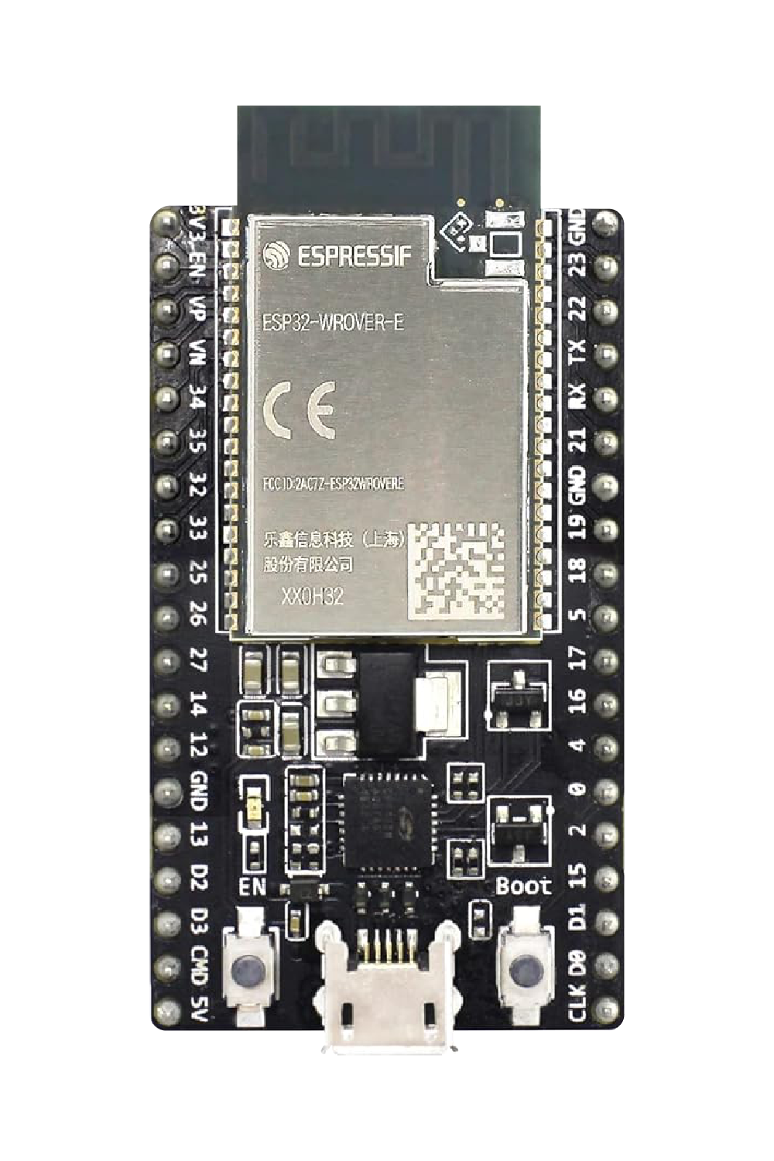
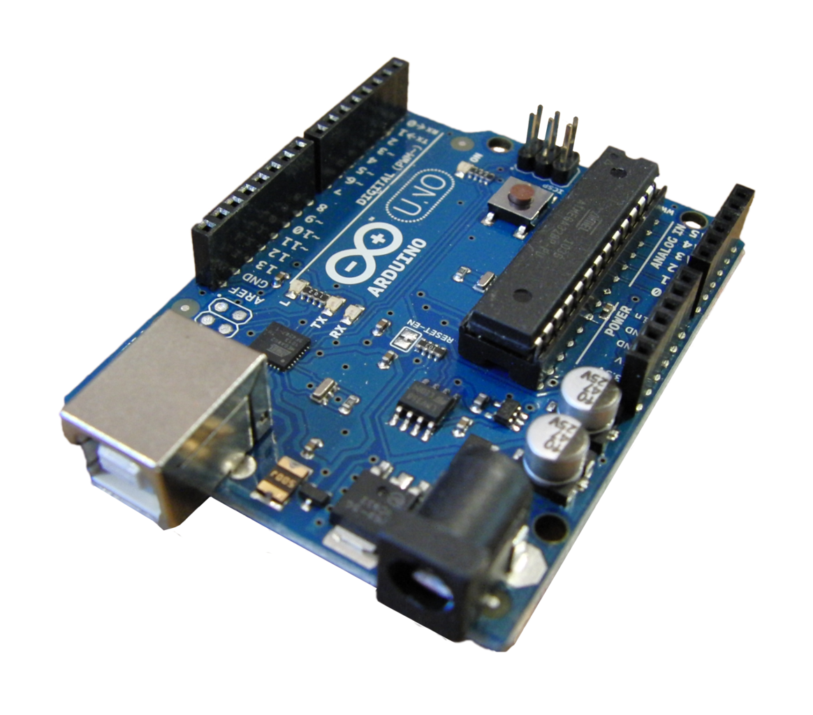
Microcontroller Selection
Andrew Herbert CPE
Choices: | MSP430FR698 | Arduino Uno | ESP32 WROOM
Frequency | 16Mhz | 20MHZ | 80MHZ
Wifi & Bluetooth | No | No | Yes
Cost | 10.05 | 1.52 | 9.99
The ESP32 is a powerful piece of hardware that integrates WiFi and Bluetooth capabilities with a wide array of peripherals and pins. It also comes with two cores, making it a dual-core processor based on the Xtensa LX6 architecture and runs at clock speeds up to 240 MHz.

Slide 9
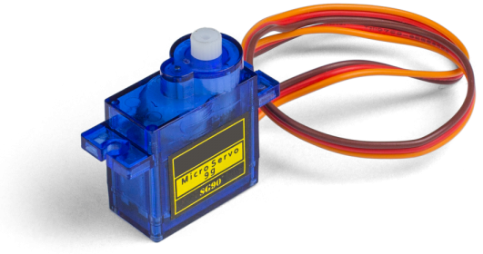
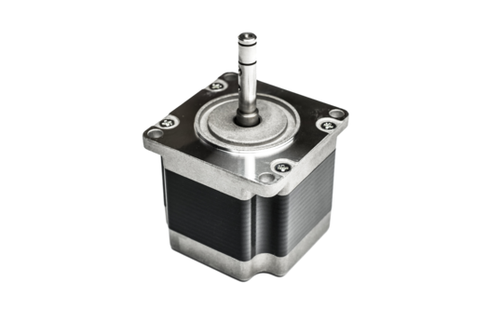
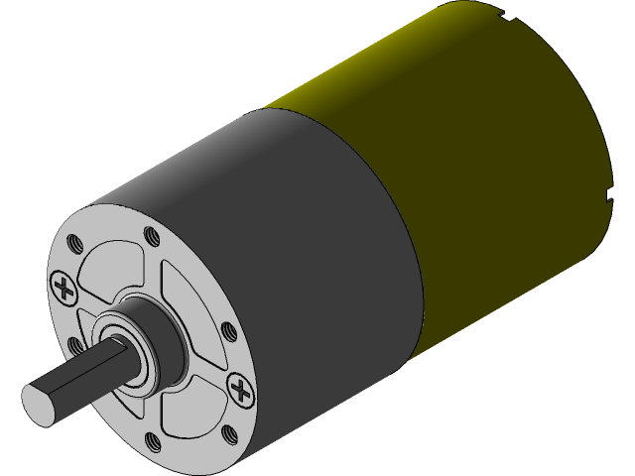
Servo and DC Motors
Andrew Herbert CPE
Motor Choices: | DC Motors | Servo Motors | Stepper Motors
Torque | High | Low | Moderate
Precision | Moderate | High | High
Cost | Moderate | Low | Moderate
Purpose:
Greartisan High Torque Motor: These two DC motors will be responsible for the horizontal and vertical movement of out turret system.
SG90 Servo Motor: The two positional servo motors will be responsible for emulating human trigger pulls on the NERF armament.

Slide 10
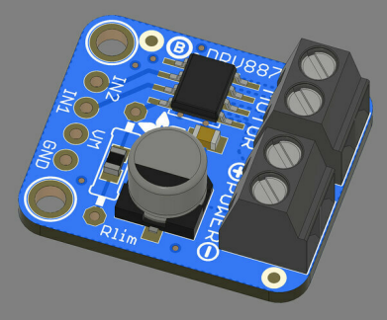
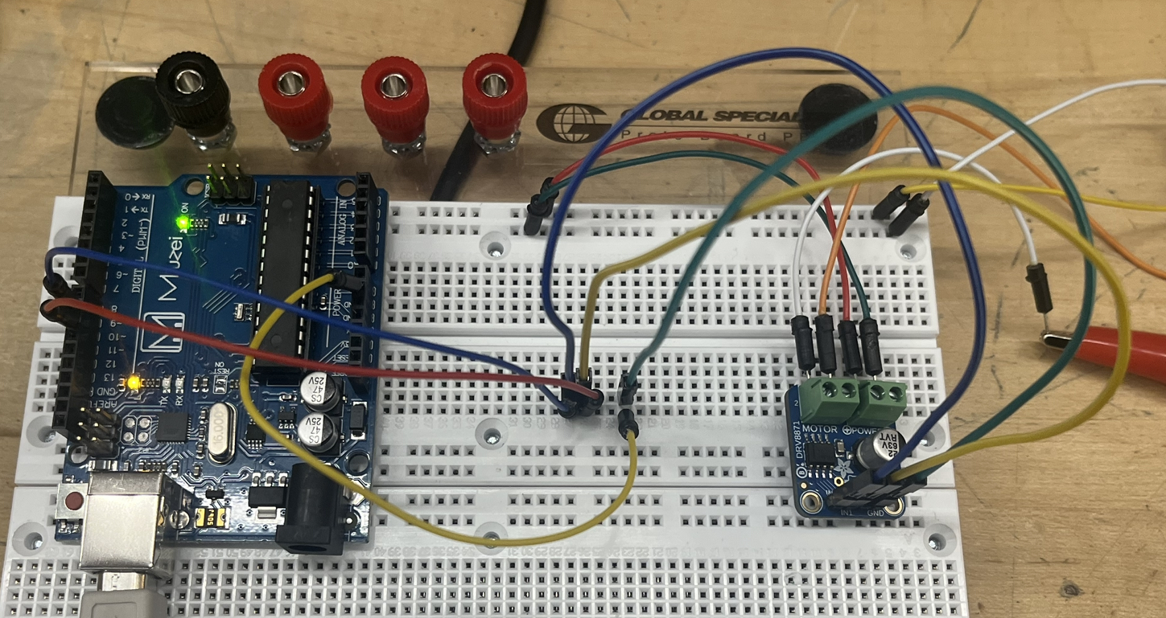
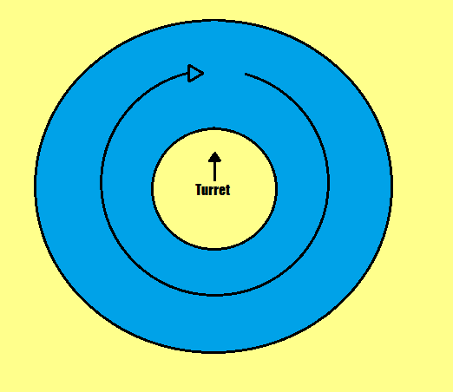
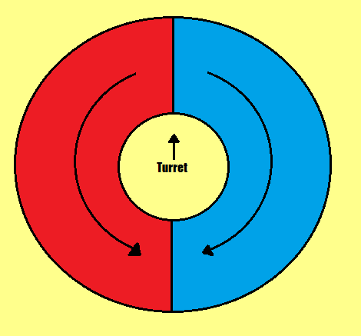
Adafruit DRV8871 Motor Breakout
Andrew Herbert CPE
A key optimization for the speed of the turret is having it move in both directions. Unfortunately, base DC motors only allow for one direction of motion at a time. By using a motor breakout we can solve this problem.
Relays Can be used as Bidirectional rotation
Problem with Mono Directional
Prototype
VS

Slide 11
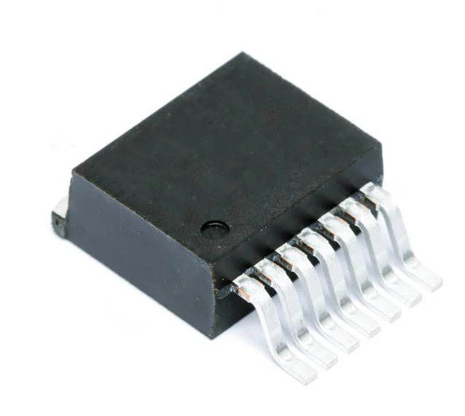
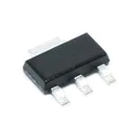
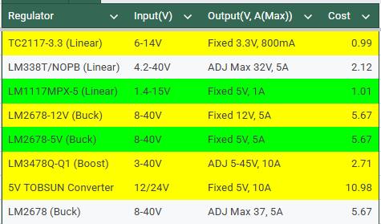
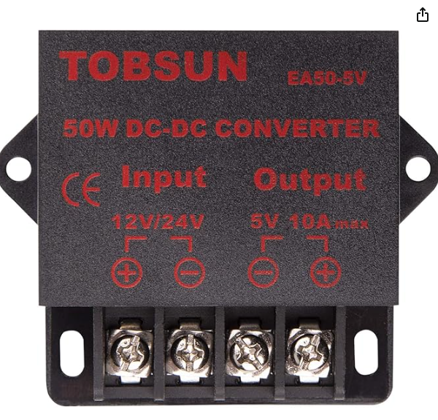
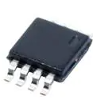
Power converters
Jose Castaneda EE

Slide 12
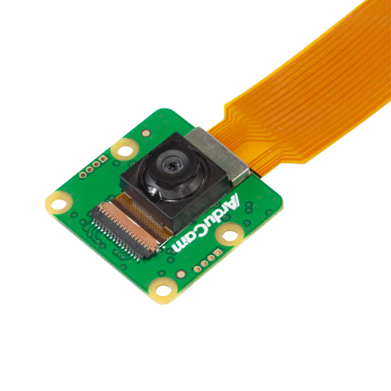
Cameras
Gabriel Taylor PSE
Purpose:
The Arducam Owlsight will provide high quality images to the Raspberry Pi 4s. This will enable image processing for object detection as well as stereo vision with accurate depth calculations
64MP resolution from a 9248x6944 pixel count
There are 2 identical cameras with 30 cm in between them
Product | Quality
Arducam Owlsight | 64MP
Raspberry Pi High Quality Camera | 12.3MP
Arducam 16MP | 16MP

Slide 13
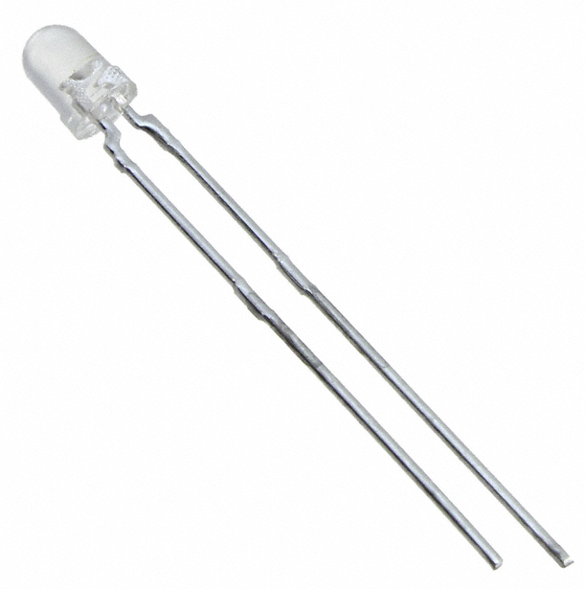
Light Emitting Diodes
Gabriel Taylor PSE
Purpose:
The LEDs emit light to the photodiodes and give a constant signal
The peak wavelength emitted is at 940 nm
They are being run at 100 mA
Product Name | Intensity | Viewing Angle
VSLB3940 | 32 mW/sr | 44°
VSMY2941GX01 | 60 mW/sr | 16°
TSAL4400 | 16 mW/sr | 50°
QED234 | 27 mW/sr | 40°

Slide 14
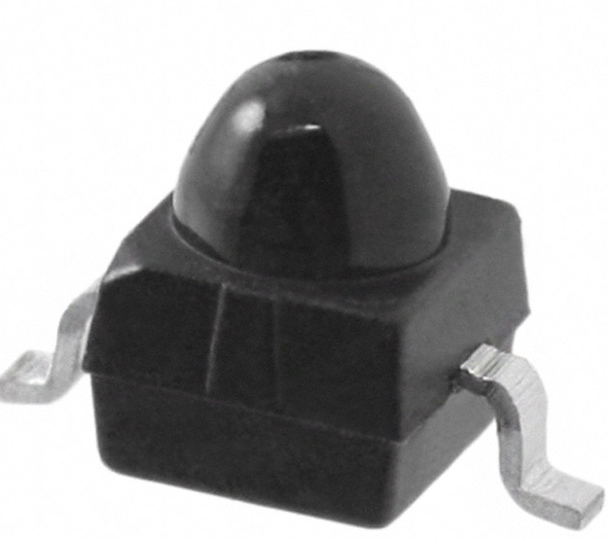
Photodiodes
Gabriel Taylor PSE
Purpose:
The photodiodes give a constant signal and when no signal is sent then the light from the LED must be blocked
The peak spectral sensitivity occurs at 940 nm
The response time is 100 ns
Product Name | Wavelength | Acceptance Angle
VEMD2020X01 | 940 nm | 30°
SFH 203 FA | 900 nm | 40°
076-14-21-011 | 660 nm | 55°

Slide 15
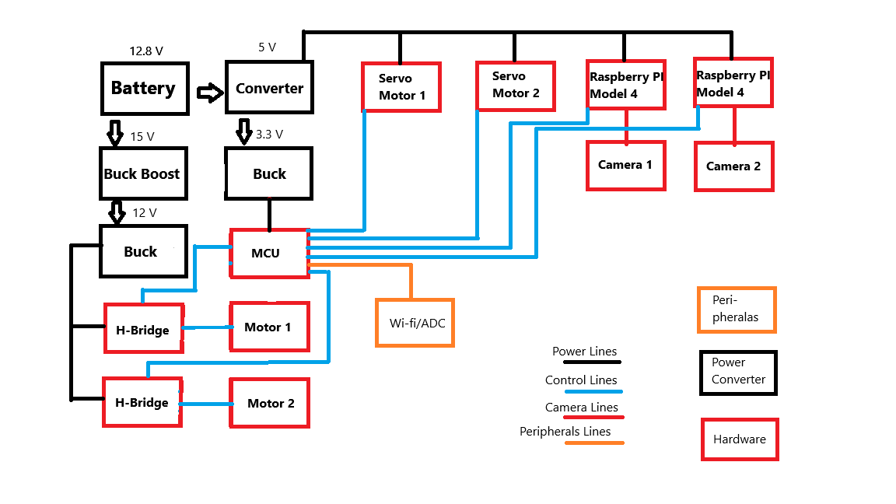
ALT-F4 Block Diagram
Jose Castaneda EE

Slide 16
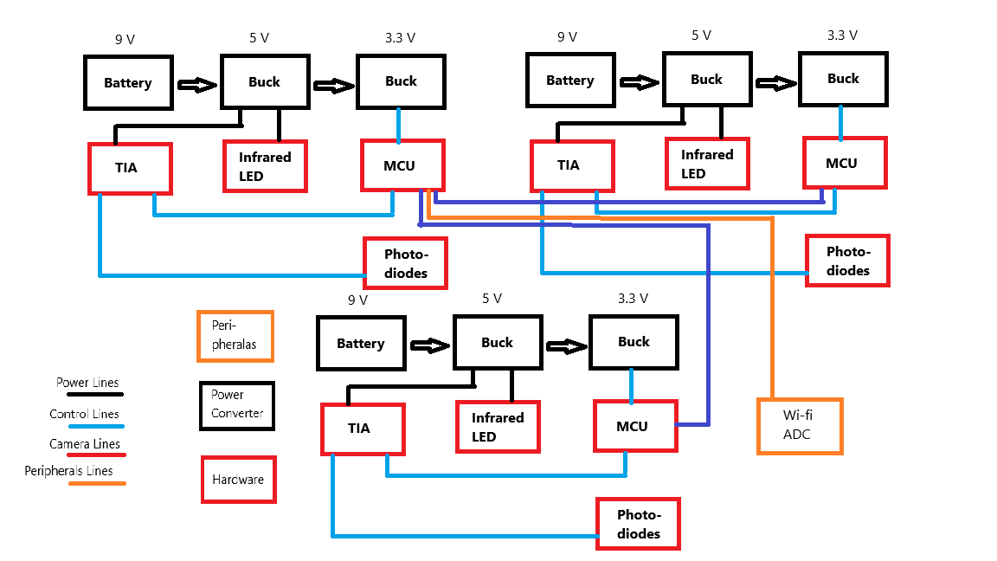
Photodetector Block Diagram
Jose Castaneda EE

Slide 17
Power Distribution
Jose Castaneda EE
ALT-F4
2 - Raspberry Pi Model 4 (5V)
  In use application 1 to 1.5 A or 3A max
2 - DC motors W/ H-Bridge (12V)
  Idle In use application .3 Amps
2 - Servo motors (5V)
  In use application .6 Amps
1 - ESP32 WROOM (3.3V)
  In use current 400 to 500 mA
1 - 3.3V LDO (5V)
  In use power Approximately .68W to .85W wasted in on heat
1 - 15V Boost & 12V Buck 90% efficiency
  In use power is 1.11W for each motor is loss in heat
1 - 5V Converter TOBSUN
  In use power is about 4W
Main Battery LiFePo 12V 30Ah or 360Wh
Total Power used in application 29.84W to 38.07W
Photodetector (1 out of 3)
1 - IR LED (5V)
  In use application 100 mA
10 - photodiodes
  In use application no power consumption
5 - OPA2380 (5V)
  In use application 10 mA
1 - ESP32 WROOM (3.3V)
  In use current 400 to 500 mA
1 - 3.3V LDO (5V)
  In use power .68W to .85W wasted on heat
1 - 5 LDO (9V)
  In use power 2.6W wasted in heat
Main Battery Li-On 9V 1.3Ah or 11.7W
Total Power used in application 4.67W to 5W

Slide 18
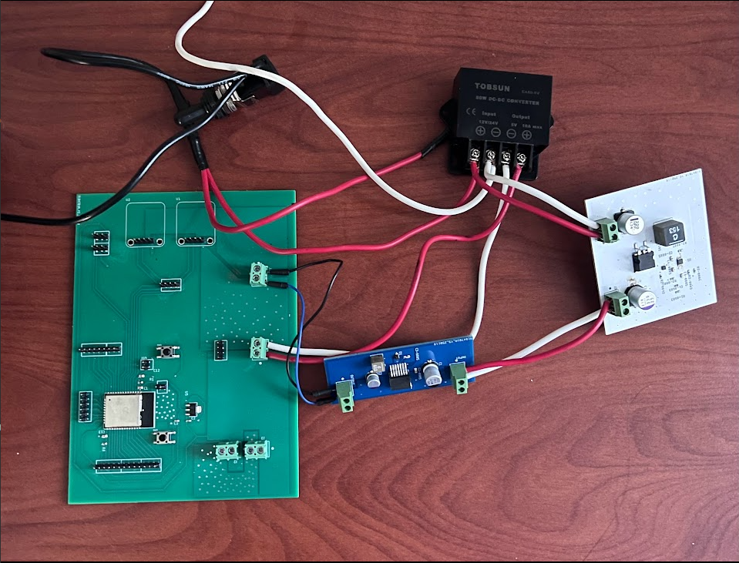
ALT-F4 W/ Power Supply
Jose Castaneda EE
Issues:
Changing the Output power to USB A instead of two terminal plug in for easier connections
H-Bridge Connections Input Correct but delivery to Motors Incorrect
Size of PCB needs to be reshaped for the Turret to be stored inside of.and maybe some connection points for placement of Power connections

Slide 19
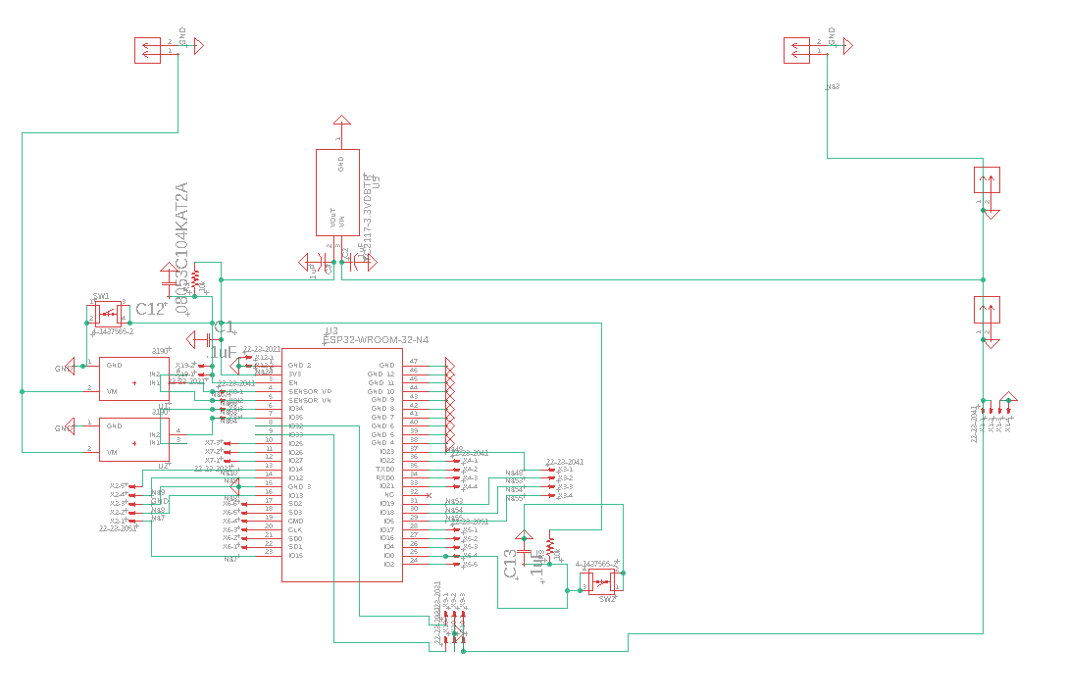
ALT-F4 Schematic
Jose Castaneda EE

Slide 20
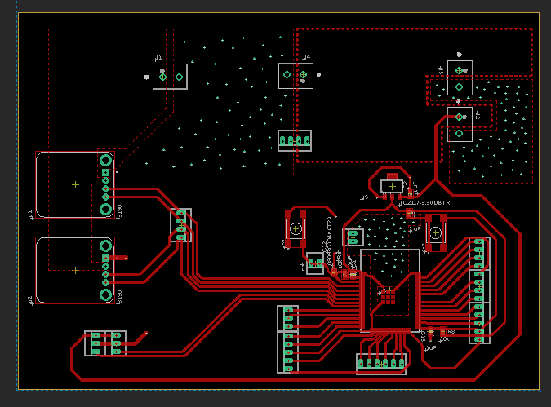
ALT-F4 PCB
Jose Castaneda EE

Slide 21
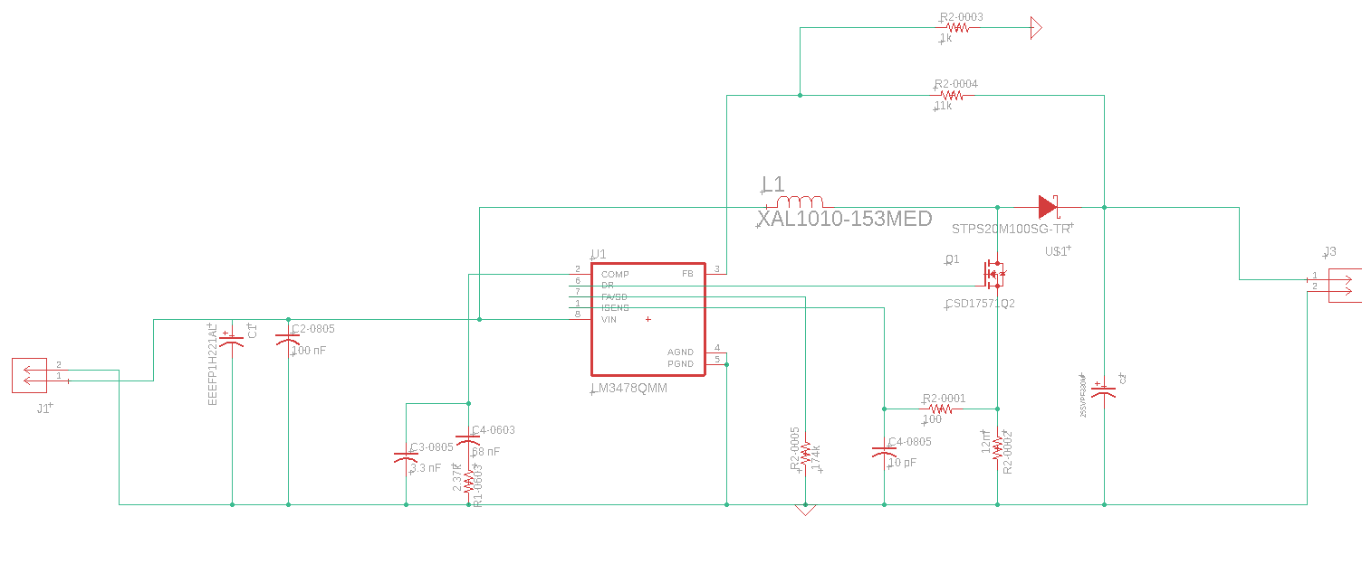
15 Volt Boost Buck Schematic (WEBENCH)
Jose Castaneda EE

Slide 22
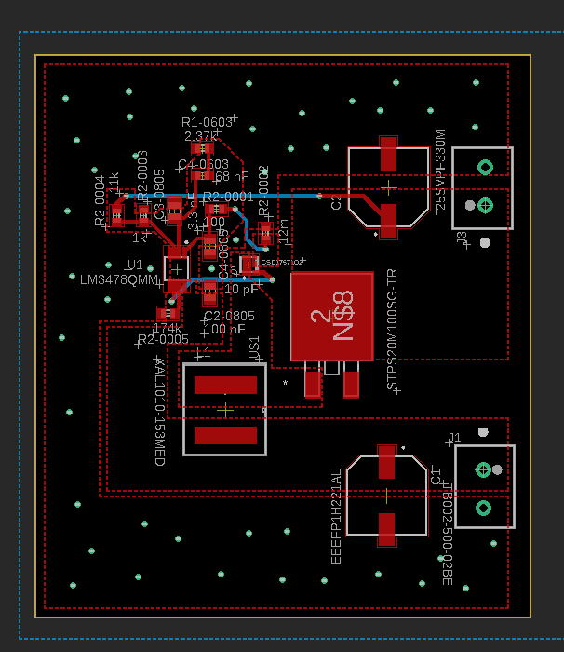
15 Volt Boost Buck PCB (Data Sheet)
Jose Castaneda EE

Slide 23
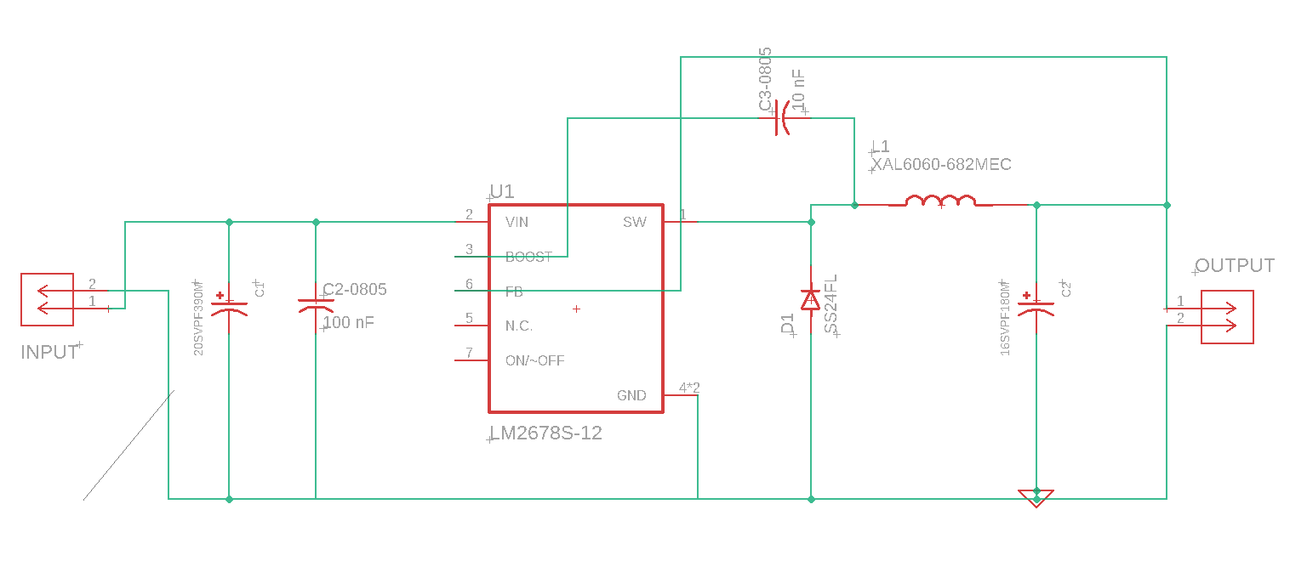
12 Volt Buck Schematic (WEBENCH)
Jose Castaneda EE

Slide 24
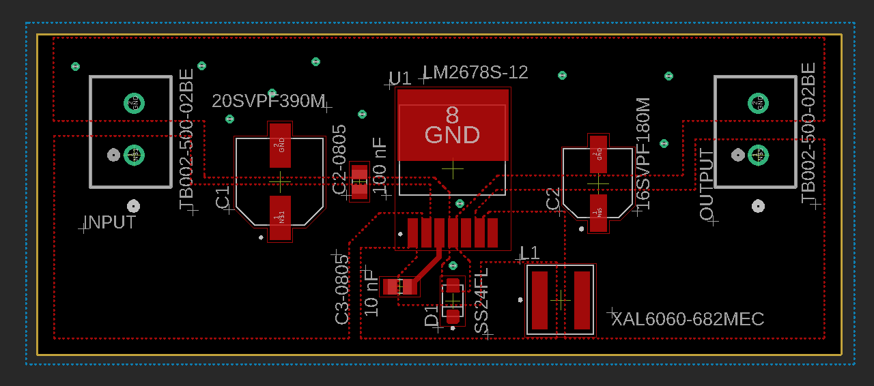
12 Volt Buck PCB (Data Sheet)
Jose Castaneda EE

Slide 25
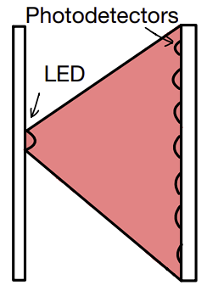
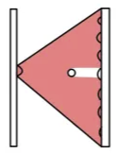
Photodetector Grid
Gabriel Taylor PSE
There will be 3 grids in succession each with 10 photodetectors opposite one LED
The photodetectors will be sending a constant signal when no object is passing through
As an object passes through the grid, the photodetector will stop sending a signal as the object blocks the light from the LED

Slide 26

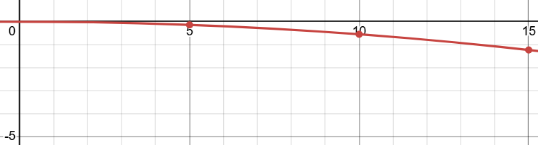
Calculating trajectory
Gabriel Taylor PSE
The photodetectors give us the relative position of the projectile at 3 different points
The trajectory of an object can be represented with the following equation
a represents the launch angle while b represents the initial velocity
A calibration shot is done at a 0 degree launch angle and knowing 3 different points allows for b to be calculated for each NERF blaster

Slide 27
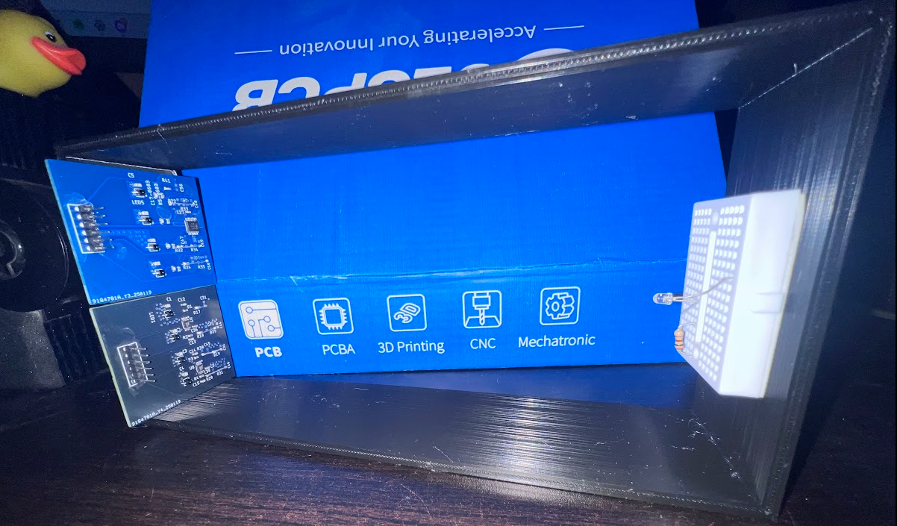
Prototyping Photodetector
Jose Castaneda EE
From simple Design use of TIA we can show proof of readings from the photodiodes by showing Voltage readings gained from the IR LED
Dimensions(mm): 220W x 100H x 50.8L. With TIA Design of 1Mohm gain is 1.1V and depend on W for Voltage. Limited on size cause of 3d printer
V=IxR, I=Current of photodiodes when light hit(1.1uA) and no light(0A) @220mm distance, R = 1Mohm(no higher because of noise)

Slide 28
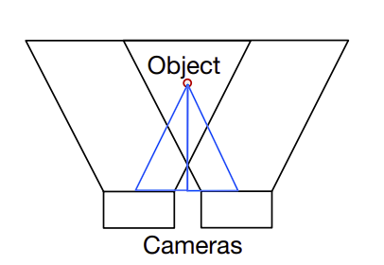
Stereopsis
Gabriel Taylor PSE
Two cameras are used to determine how far away an object is
The relative position of an object in one camera compared to the relative position in the second camera is sent to a code
Python takes this information and can determine how far away an object is

Slide 29
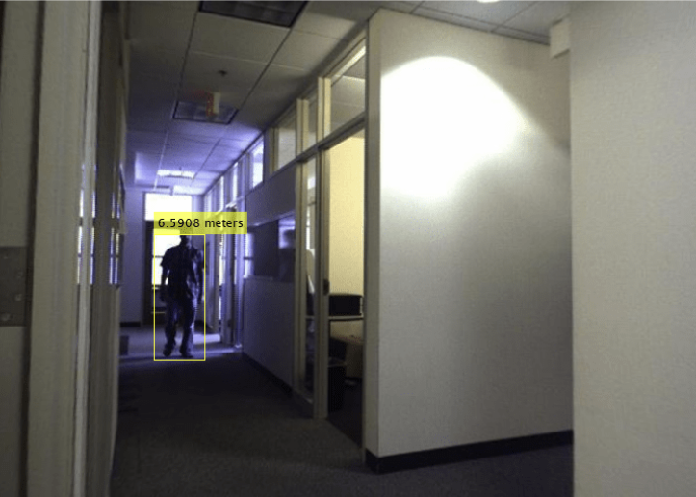
Stereopsis
Gabriel Taylor PSE
Stereopsis can be done on multiple points not just the center point
Utilizing the object detection, Stereopsis can determine roughly how far away said object is from the turret
Distance in meters | Uncertainty in meters
10 | ±.05
15 | ±.15
20 | ±.2
25 | ±.3
30 | ±.45

Slide 30
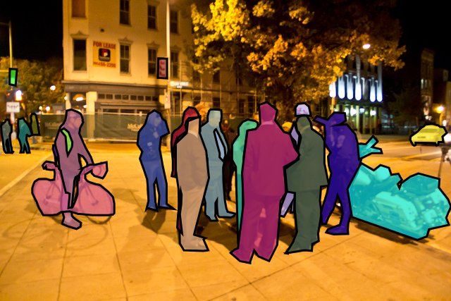
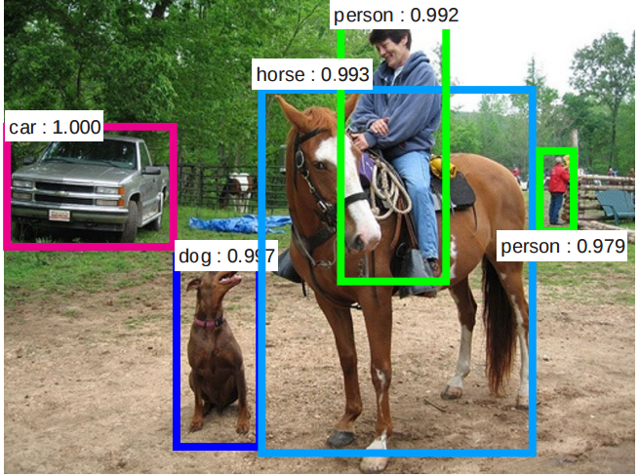
Image Processing
Joshua Nguyen CPE
OpenCV Library
Object Detection:
  A pre-trained SSD-MobileNetV3 with COCO Library.
Raspberry Pi Camera Module (Arducam)
  Sends video feed to ML model for image processing
  Search for target within the frame.
UART Serial Communication to ESP32
  Send target coordinates to microcontroller which will activate the motors.

Slide 31
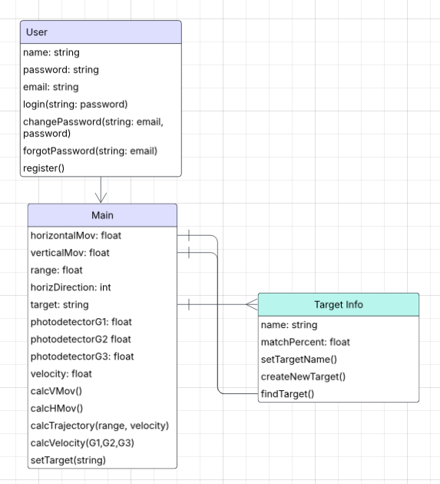
Class Diagram
Andrew Herbert CPE

Slide 32
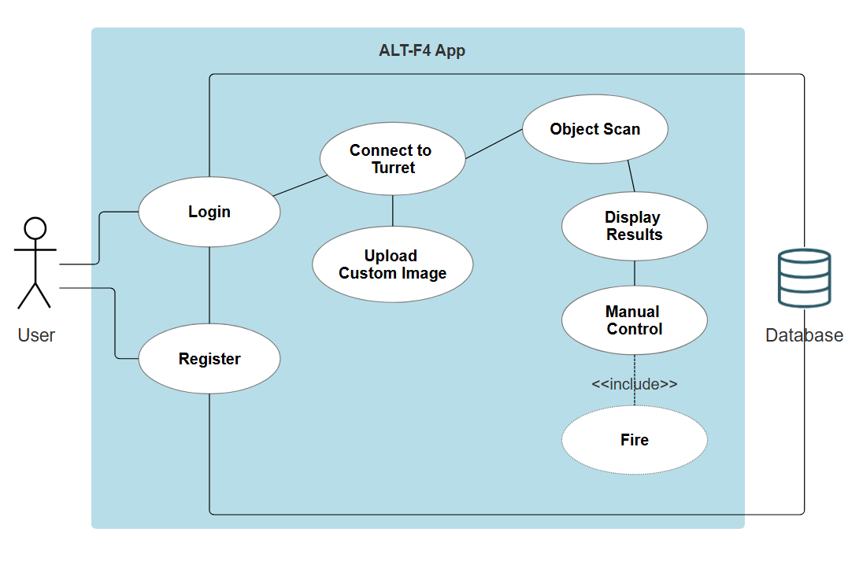
Use Case Diagram
Joshua Nguyen CPE

Slide 33



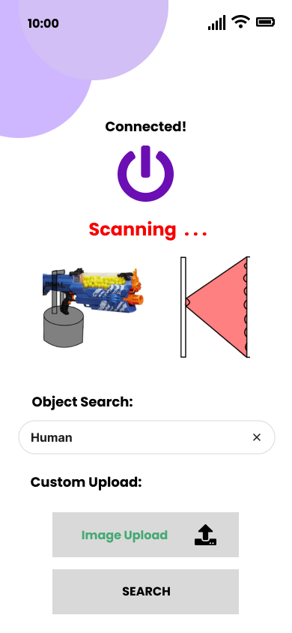
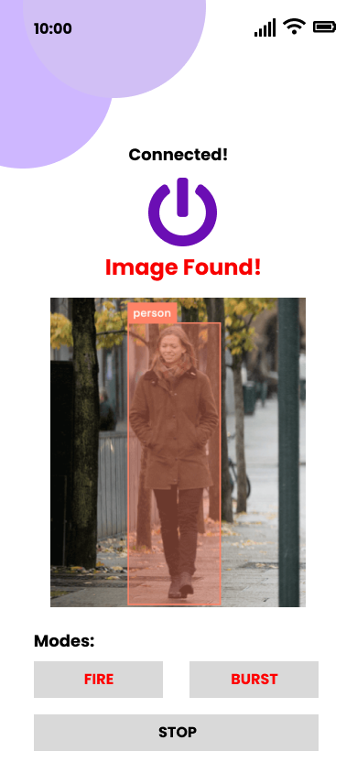
App Interface Design
Joshua Nguyen CPE

Slide 34
Register / Login
Joshua Nguyen CPE
Features:
Account Creation
Email Confirmation
User data stored in MongoDB Database

Slide 35
Home Page Interface
Joshua Nguyen CPE
Features:
Search for a specific object
  Ex: Human, Car, Bottle
Custom Upload
  Upload the name and image of the desired person.
Send signal to find target.

Slide 36
Turret Body
Andrew Herbert CPE
Comprised of multiple key parts:
Motor Base stand will be pyramidal in structure and have the DC motor responsible for horizontal movement.
The hardware cylinder will spin horizontally with the turret and house our electronics and PCB.
Baseplate is a combination of a lid for the hardware cylinder and contains a compartment for the lithium phosphate battery.
The arm will be affixed to baseplate and support our rail system that will hold the armament a DC motor mounted to the arm will support vertical movement.
Rail System will attach to the arm and depending on the armament used will be able to adjust its height allowing.

Slide 37
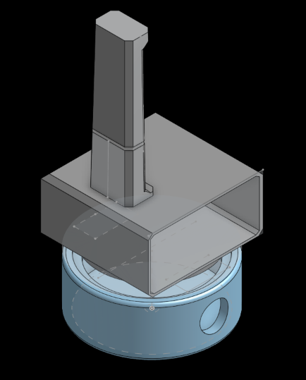
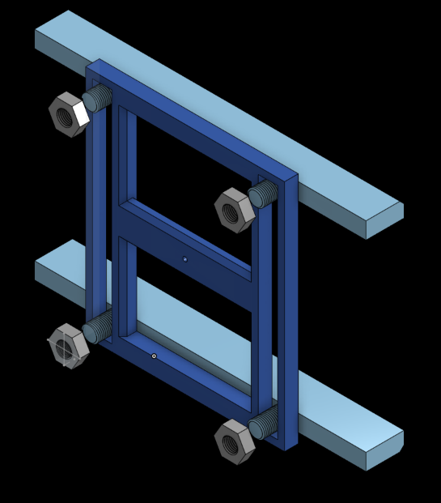
3D Fabrication
Andrew Herbert CPE
Dremel 3D printing allows for non-commercial available parts to be fabricated.
Pros: Allows for custom designs,Quite Affordable, Durable with low infill
Cons: Fabrication time
Onsite Printing options: SD Lab, TI ENG Lab, CMC Library

Slide 38
Administrative Content
Andrew Herbert CPE

Slide 39
Work Distribution
Andrew Herbert CPE
Andrew Herbert | Gabriel Taylor | Joshua Nguyen | Jose Castaneda
Web Server and App | Photodetector LED Grid | Motor Setup | Power Supply
Image Processing | Image Processing | PCB Design | PCB design
Motor Setup | 3D Modeling and Fabrication | ESP32 WROOM | 3D modeling and Fabrication
PCB Design | PCB Design | Web Server | Motor Setup
3D Modeling and Fabrication | Assembly of Prototype | App Development | Assembly of Prototype
Assembly of Prototype |  | Assembly of Prototype

Slide 40
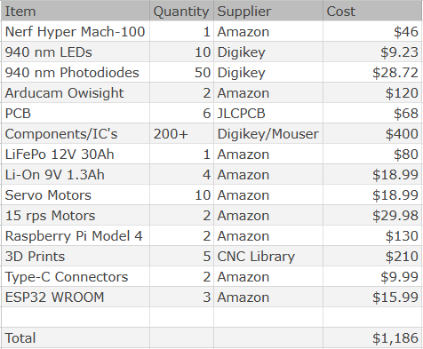
Bill of Materials
Andrew Herbert CPE

Slide 41
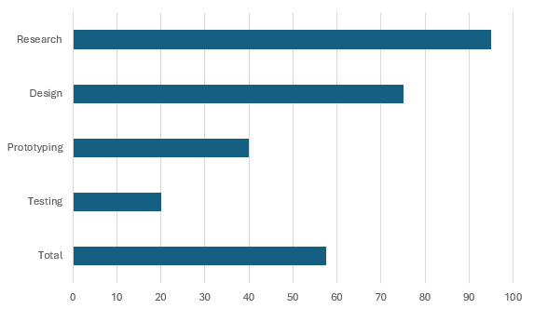
Progress
Andrew Herbert CPE

Slide 42
Issues
Andrew Herbert CPE
Making ALT-F4 available for holding and shooting all types of armaments
Speed of the NERF bullet traveling across the photodetector at the moment is to fast for response.
Making the Photodetectors cost effective since TIA can cost up to $6 - $16 each and most can only do up to 2 circuits each. At the moment, we are using OPA2380.

Slide 43

Questions?
Thank you!

